Slide 1
Introducing spreadsheets
Lesson 3: Boolean operators and the IF and COUNT functions

Slide 2
Objectives
In this lesson you will learn:
the Boolean operators
how to write functions using IF
how to write functions to COUNT the number of items in a range
understand the difference between the COUNT and COUNTA functions.

Slide 3
The IF game
Stand up IF …
… you have a birthday in December.
Sit down IF …
… you have at least one sister.
Stand up IF …
… you like chocolate.
Put your finger on your nose IF …
… you can explain an absolute cell reference.

Slide 4
The IF function
The IF function is used to make choices.
It has the following structure: =IF( Question, Do this if True, Do this if False ).
The question is a logical test or logical expression to which the answer can be either True or False.

Slide 5
Boolean operators
The logical test in an IF function uses Boolean operators:
> | greater than
< | less than
= | equal to
>= | greater than or equal to
<= | less than or equal to
<> | not equal to

Slide 6
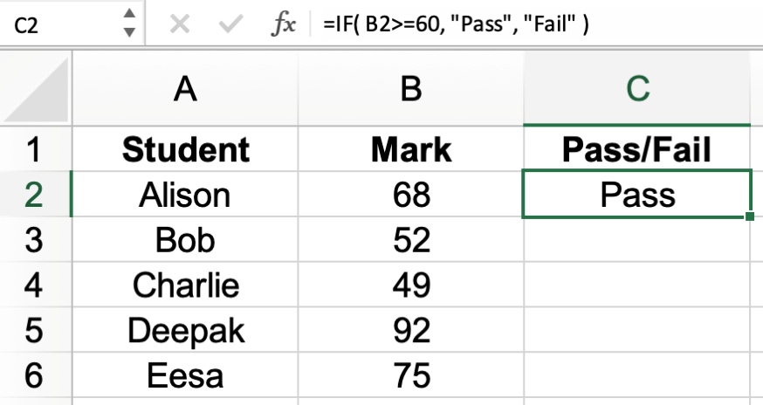
Using the IF function
Value to be returned if the condition is True
Logical test
Value to be returned if the condition is False
Now watch video 3.1

Slide 7

Activity 3.1: Test marks 1

Slide 8
The COUNTIF function
The COUNTIF function counts the number of cells in a selected range that meet a specific criterion.
It has the following structure: =COUNTIF( Range, Criterion ).
The range selects the cells to be checked.
The criterion is the condition that determines which cells will be counted. It can be a number, a mathematical expression or text that needs to be matched.

Slide 9
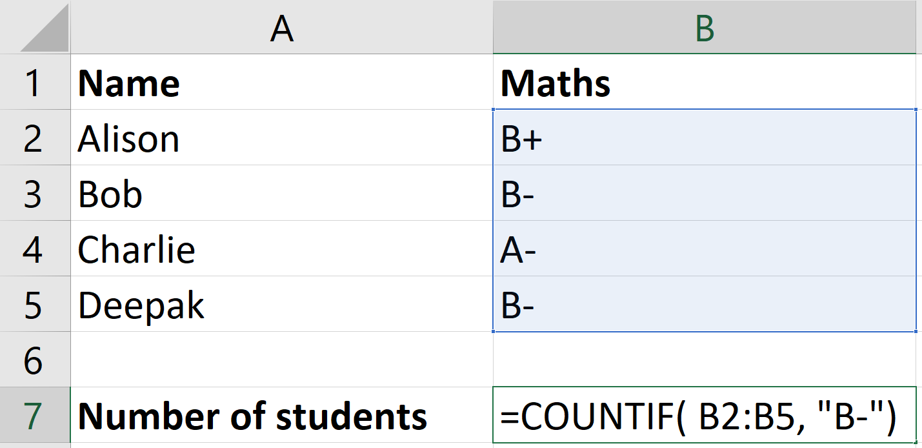
Using the COUNTIF function
To find out how many students got a B- use:
=COUNTIF( B2:B5, "B-" )
Now watch video 3.2

Slide 10
Activity 3.2: Test marks 2

Slide 11
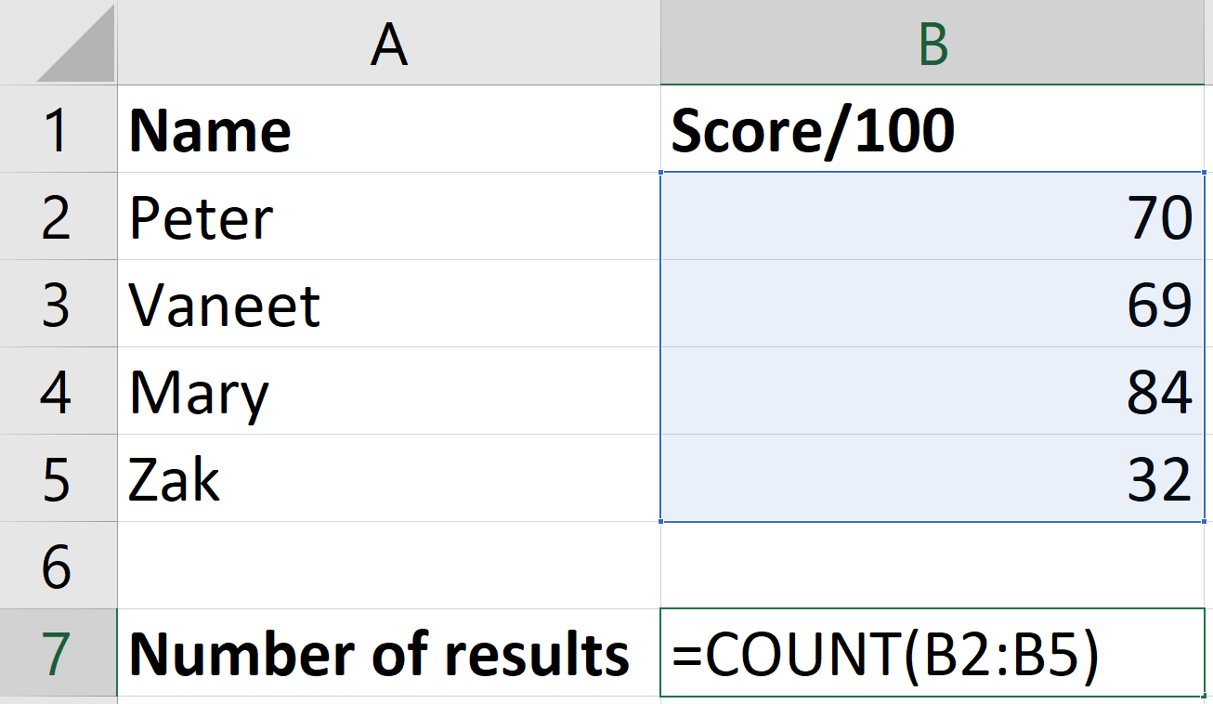
The COUNT function
The COUNT function counts the number of cells in a selected range that contain a number.
Now watch video 3.3

Slide 12
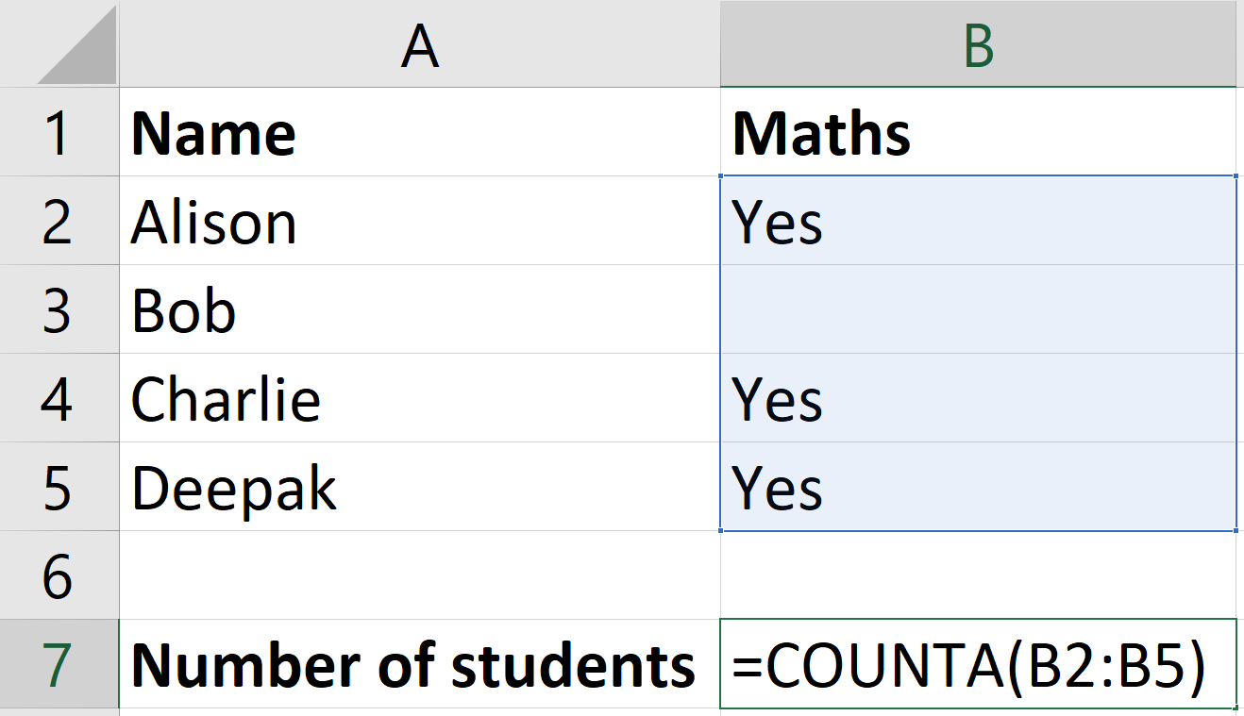
The COUNTA function
The COUNTA function counts the number of cells in a selected range that contain a value (text or a number).
Now watch video 3.4

Slide 13
Activity 3.3: Ifcity Zoo

